Slide 1
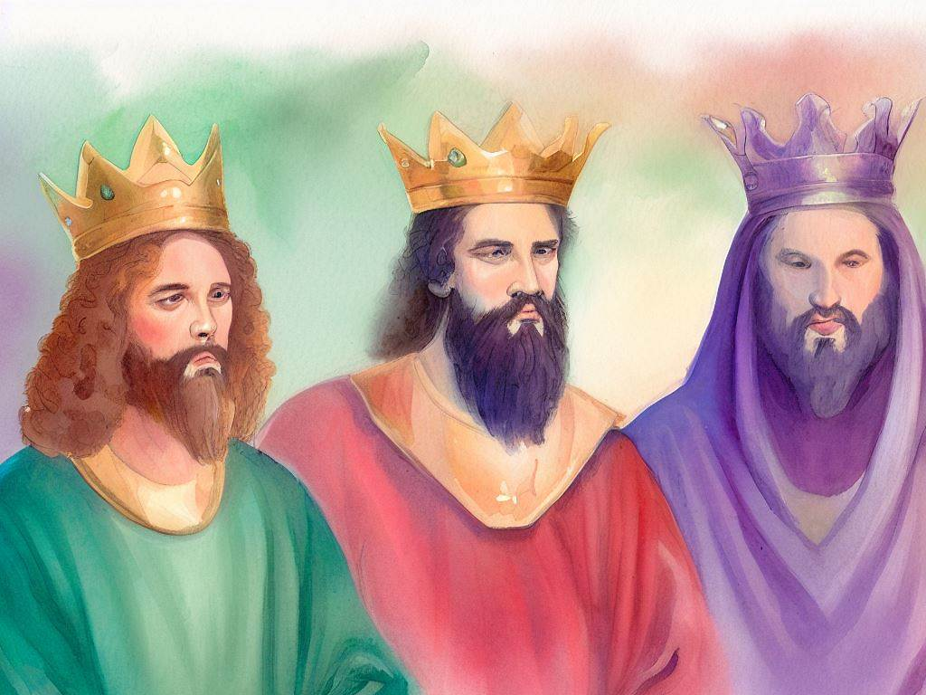
United Kingdom
Quarter 4: Lesson 21
David’s Sin & Repentance (2 Samuel 11 & 12)

Slide 2
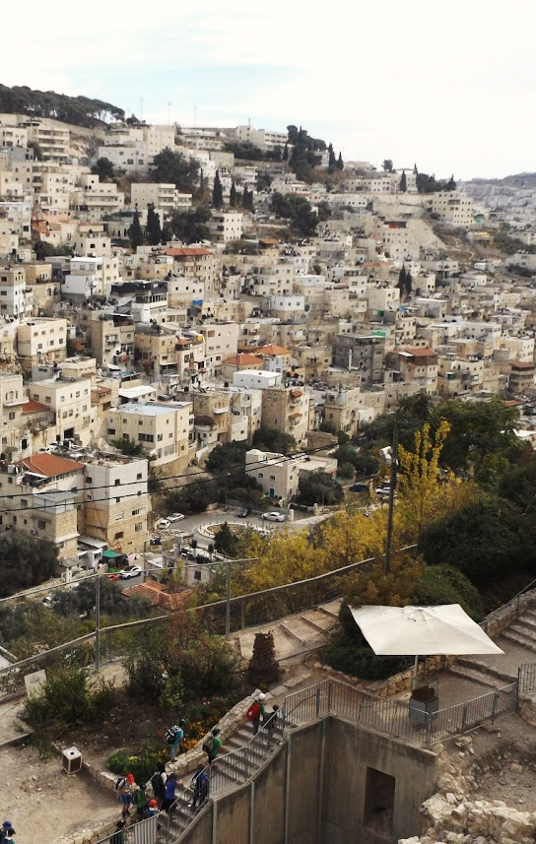
David’s Sin & Repentance
David’s Sin (2 Samuel 11)
David’s Repentance (2 Samuel 12)
Notes:
The map shows the land that Israel inhabited (in orange) and the land that David conquered and controlled during his reign.

Slide 3
David’s Sin (2 Samuel 11)
Introduction:
David, a man after God’s own heart (1 Samuel 13:14; Acts 13:22)
Things to remember…
David repented of his sins when they were exposed.
He never failed to acknowledge the One True God.
Notes:
1Sa 13:14 "But now your kingdom shall not continue. The LORD has sought for Himself a man after His own heart, and the LORD has commanded him to be commander over His people, because you have not kept what the LORD commanded you.“
Ac 13:22 "And when He had removed him, He raised up for them David as king, to whom also He gave testimony and said, 'I have found David the son of Jesse, a man after My own heart, who will do all My will.'

Slide 4
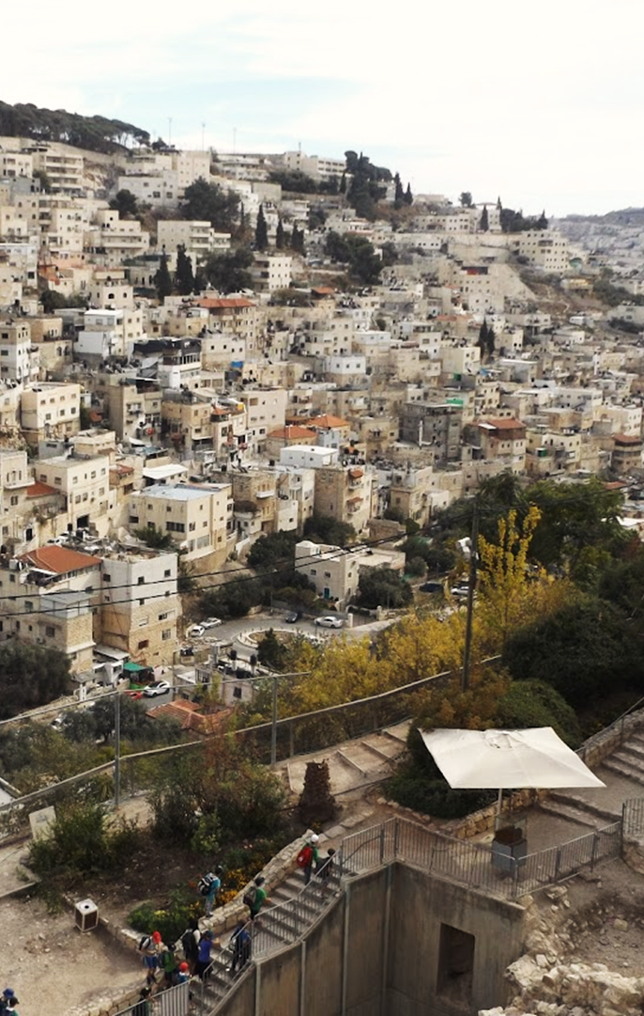
David’s Sin (2 Samuel 11)
David Remains at home (11:1).
Sets stage for tragedy to follow.
David commits adultery (11:2-5).
He saw from the roof a woman bathing.
Text does not indicate anything improper about Bathsheba’s bathing in such a place.
But was she as discreet as she should have been?
Regardless, David had no business looking, lusting after his neighbor’s wife.
So much sorrow could have been avoided had David looked another way.
Notes:
David already had wives and concubines
Satisfying lust only intensifies the desire and power of the sin

Slide 5
David’s Sin (2 Samuel 11)
David commits adultery (11:2-5).
“Is not this Bathsheba, the daughter of Eliam, the wife of Uriah the Hittite?” (11:3)
Bathsheba is also called Bathshua the daughter of Amiel (1 Chronicles 3:5)
Eliam = Amiel. The meaning is the same.*
Eliam son of Ahithophel (2 Samuel 23:34).
Notes:
* Both names roughly translate to “my kinsmen is God”

Slide 6
David’s Sin (2 Samuel 11)
David commits adultery (11:2-5).
Is not this Bathsheba, the daughter of Eliam, the wife of Uriah the Hittite (11:3).
Uriah’s name indicated a worshipper of Jehovah
He is a high-ranking officer of David -- One of David’s ‘30’ mighty men (2 Samuel 23:39; 1 Chronicles 11:41)
So David sent messengers and took her (11:4).
There is no suggestion of unwillingness on her part, but what if she had refused the king?
Being cleansed from her impurity may help explain why conception followed immediately (cf. Leviticus 15:28).
Notes:
Leviticus 15:28 'But if she is cleansed of her discharge, then she shall count for herself seven days, and after that she shall be clean.

Slide 7
David’s Sin (2 Samuel 11)
David commits adultery (11:2-5).
And he lay with her (11:4).
David stoops to rob one of his officers of his honor – a grievous sin.
James 1:14-16 – “But each one is tempted when he is drawn away by his own desires and enticed. Then, when desire has conceived, it gives birth to sin; and sin, when it is full-grown, brings forth death. Do not be deceived, my beloved brethren.”
David’s choice sets in motion a cascade of tragic events for David’s house.

Slide 8
David’s Sin (2 Samuel 11)
David commits adultery (11:2-5).
And she sent and told David, “I am with child” (11:5)
David and Bathsheba are guilty of a sin punishable by death (Leviticus 20:10).
Bathsheba’s message implies an expectation; she needs David to handle the situation.
The sin would become obvious since Uriah was away at war.
David has misused his power to commit adultery and will now misuses it to try to cover his sin and avoid punishment (Proverbs 28:13).
Notes:
Lev 20:10 'The man who commits adultery with another man's wife, he who commits adultery with his neighbor's wife, the adulterer and the adulteress, shall surely be put to death.
Proverbs 28:13 He who covers his sins will not prosper, But whoever confesses and forsakes them will have mercy

Slide 9
David’s Sin (2 Samuel 11)
David attempts a cover-up (11:6-13).
He has Joab send Uriah back from the battlefield to report to David (11:6-7).
David’s purpose is to arrange a conjugal visit between Uriah and Bathsheba to make it appear that Bathsheba’s child is Uriah’s (11:8).
When Uriah refuses to visit his wife “while the ark and Israel are dwelling in tents,” David gets him drunk, but Uriah still does not visit his wife (11:9-13).
Notes:
Proverbs 28:13 He who covers his sins will not prosper, But whoever confesses and forsakes them will have mercy.

Slide 10
David’s Sin (2 Samuel 11)
David murders Uriah (11:14-21).
David sends a message to Joab by Uriah. Uriah is to be placed in the hottest part of the battle “that he may be struck down and die” (11:14-15).
Joab does as commanded and sends news back to David about the fighting; Joab anticipates that the unnecessary casualties would be excused as the cost of having Uriah killed (11:16-21).
When David hears the news, he diminishes Uriah’s death by saying “the sword devours one as well as another” (11:22-25).
After Bathsheba mourns Uriah, she and David marry. “But the thing displeased the Lord” (11:26-27; cf. Hebrews 4:13).
Notes:
Nothing is hidden from the eyes of the Lord. Hebrews 4:13 And there is no creature hidden from His sight, but all things are naked and open to the eyes of Him to whom we must give account.

Slide 11
David’s Sin (2 Samuel 12)
The Parable of the Ewe Lamb (12:1-6).
The Lord sent Nathan to David (12:1).
Parable of the poor man’s ewe lamb (vs 1-4)
Characters: Rich man = David Flocks and herds = David’s wives and concubines Poor man = Uriah Ewe lamb = Bathsheba
The parable illustrates the arrogant and selfish attitudes and actions of the privileged and powerful who oppress and plunder the common people for their own gain.

Slide 12
David’s Sin (2 Samuel 12)
The Parable of the Ewe Lamb (12:1-6).
David’s judgment (vs 5-6)
David was angry – there is no anger so hollow as the righteous anger of a hypocrite.*
“As the LORD lives, the man who has done this shall surely die! And he shall restore fourfold for the lamb” (cp. Exodus 22:1).
Notes:
Ex 22:1 "If a man steals an ox or a sheep, and slaughters it or sells it, he shall restore five oxen for an ox and four sheep for a sheep.
It is always easy to look past our own sins and see sin in others

Slide 13
David’s Sin (2 Samuel 12)
The Lord’s indictment and sentence (12:7-12).
Thou art the man! (12:7).
God had given David so much and would have given him much more (12:8).
Yet, David had despised the word of the Lord and done evil in His sight (12:9).
The sword would never depart from his house (12:10).
The Lord declares, “I will take your wives before your eyes and give them to your neighbor” (12:11-12).
Notes:
Three of David’s sons will be murdered Amnon by Absalom Absalom by Joab Adonijah by Solomon
I have sinned against the Lord (vs 13a)
“The glory of David”, a man a after God’s own heart
No excuses No blame No extenuating circumstances Just stark confession of his sin against God and willingness to accept the consequences

Slide 14
David’s Sin (2 Samuel 12)
David confesses his sin, but consequences would still be suffered (12:13-14).
“I have sinned against the Lord” (12:13a).
The Lord has put away your sin, you shall not die (12:13b).
The child who is born to you shall die (12:14)
Even when forgiven, there may yet be MANY unpleasant temporal consequences.
Notes:
I have sinned against the Lord (vs 13a)
“The glory of David”, a man a after God’s own heart
No excuses No blame No extenuating circumstances Just stark confession of his sin against God and willingness to accept the consequences

Slide 15
David’s Sin (2 Samuel 12)
In the aftermath of David’s sin…
David’s child dies (12:15-23)
David prays and fasts for 7 days as the child languishes.
He ends his fast when the child dies. “Can I bring him back again? I shall go to him, but he shall not return to me."
Solomon is born (12:24-25)
David comforts Bathsheba and she bears a son. David named Solomon. But he also called him Jedidiah because the Lord loved him.
Ammon is defeated (12:26-31).
Notes:
I have sinned against the Lord (vs 13a)
“The glory of David”, a man a after God’s own heart
No excuses No blame No extenuating circumstances Just stark confession of his sin against God and willingness to accept the consequences

Slide 16
Applications
Each one is tempted when he is drawn away by his own desires.
Flee sexual immorality.
One sin often leads to other sins.
Sin will take you farther than you meant to go, keep you longer than you meant to stay, and cost you more than you meant to pay.
Wise rebuke convicts as it condemns.
When faced with our sins, contrition and confession are the proper responses – not excuses and self-justification.

